Slide 1
Wall Street Analysts’ Earnings Predictions
How Accurate are Quarterly Earnings
Prediction by Wall Street Analysts?
By Daniel Rim

Slide 2
Wall Street’s Guessing Game
Every quarter stock analysts try to guess what publicly listed companies are going to report on their earnings
Introduction in Investopedia (http://www.investopedia.com/articles/stocks/06/earningsforecasts.asp)
“A consensus forecast number is normally an average or median of all the forecasts from individual analysts tracking a particular stock. So, when you hear that a company is expected to earn $1.50 per-share this year, that number could be the average of 30 different forecasts. On the other hand, if it's a smaller company, the estimate could be the average of just one or two stock analyst forecasts.”

Slide 3
Methodology
How the analysts come up with their predictions is anybody’s guess
From Investopedia
“Many analysts will incorporate top-down factors such as economic growth rates, currencies and other macroeconomic factors that influence corporate growth. They use market research reports to get a sense of underlying growth trends. To understand the dynamics of the individual companies they cover, really good analysts will speak to customers, suppliers and competitors. The companies themselves offer earnings guidance that analysts build into the models.”

Slide 4
General Perception
Quarterly Earnings report are taken seriously in investment community
“Consensus estimates are so powerful that even small deviations can send a stock higher or lower. If a company exceeds its consensus estimates, it is usually rewarded with an increase in stock price. If a company falls short of consensus numbers - or sometimes if it only meets expectations - its share price can take a hit.”(Investopedia)
Therefore company’s real quarterly earning before reported is considered as material non-public information and it is considered insider trading to trade on the knowledge

Slide 5
Accuracy of Earnings Projections
Goal of this study was to measure how accurate Wall Street analysts’ quarterly earnings are compared to actual reported earnings numbers
CNBC provides in their website every quarter what the estimated EPS(Earnings for Share) for the company was, the actual reported EPS, and whether the actual number was above or below estimates

Slide 6
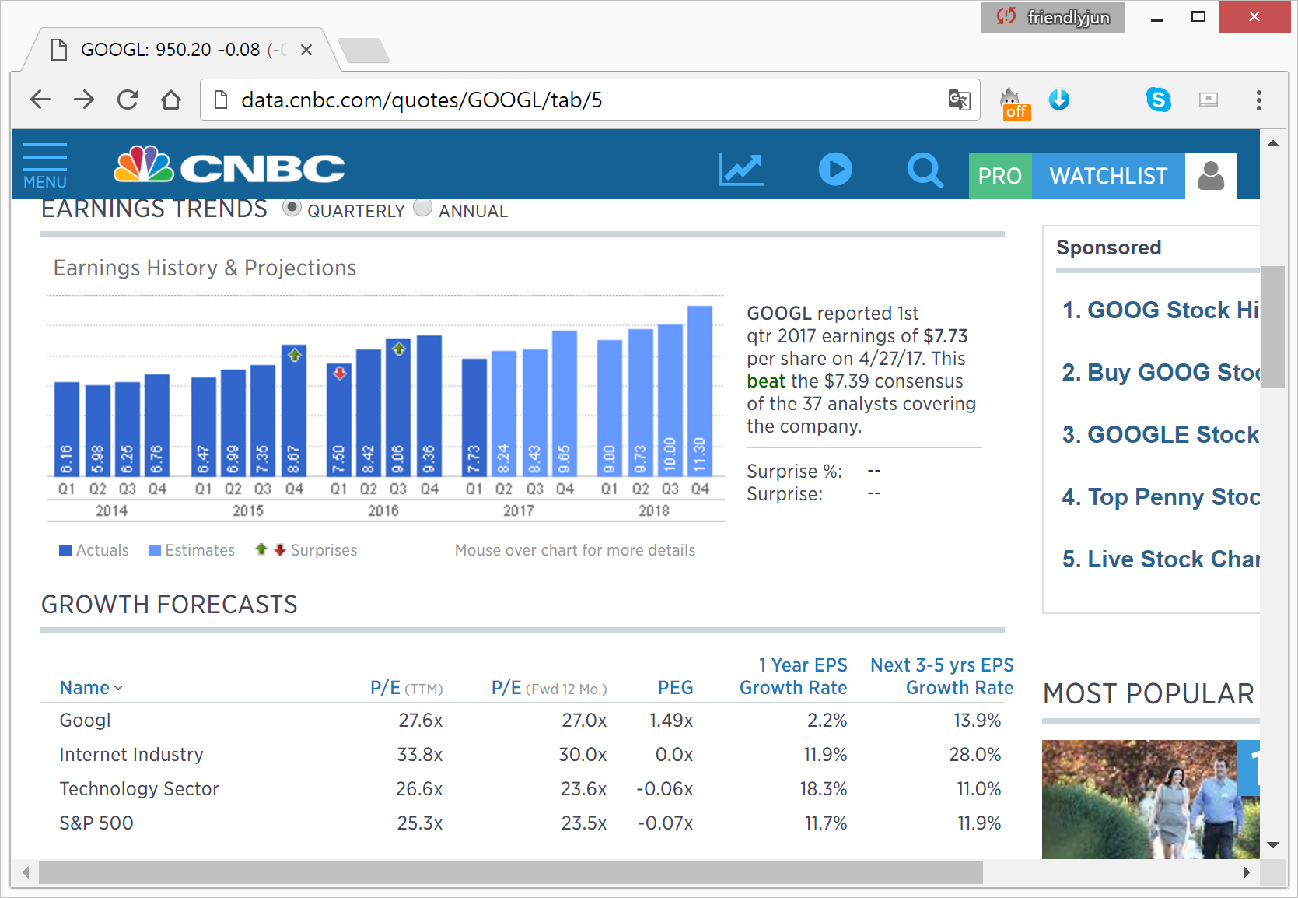
Scraping CNBC’s Earnings Data
For example, here’s Google’s Earning page of CNBC
http://data.cnbc.com/quotes/GOOGL/tab/5

Slide 7
Structure of the Page
It looks simple enough, but one would have to use Selenium to try to scrape data
Moreover, if one was trying to scrape data for past quarters, one would have to be able to hover over the bar graph and get the changed data (Also have to note that the past data would more likely lead to survivorship bias)
I have attempted to do this using button/click or hover action in Selenium but was not successful
Also, it was returning None for area objects under map (템소 = //*[@id=＂chartMap＂]/map/area[1])

Slide 8
Raw Data
I was able to scrape the most recent quarterly data for about 3000 companies
By parsing the raw data, I was able to get information for estimate quarterly EPS/actual quarterly EPS, whether it beat or missed the estimates, and number of analysts covering the stock
I have attempted to run the regression on estimate EPS vs. actual reported EPS

Slide 9
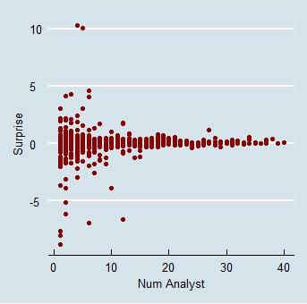
Number of Analysts covering the company and Earnings surprises

Slide 10
Simple Linear Regression
By cleaning up the data a bit so to include only names with 4th quarter of 2016 and 1st and 2nd quarter of 2017(It is currently earnings season in May of 2017; Number of companies: 3224)
Result
Beta1: 0.955634 (S.E = 0.010493, t-value = 91.070)
Beta0: 0.001079
Multiple R-squared: 0.7202
p-value: < 2.2e-16

Slide 11
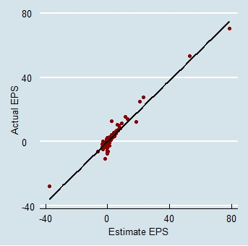
Result

Slide 12
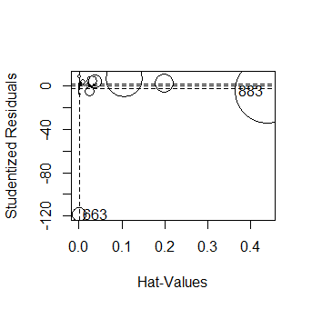
Assumption Diagnostics

Slide 13
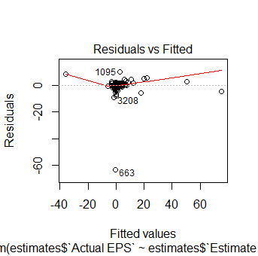
Constant Variance of Residuals Assumption

Slide 14
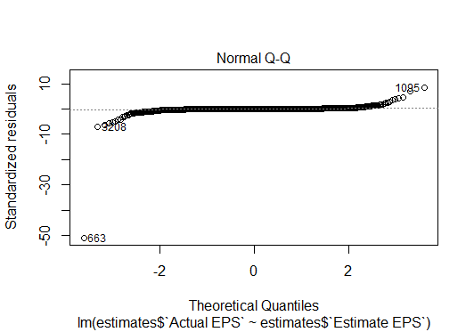
QQ Plot and test of Normality

Slide 15
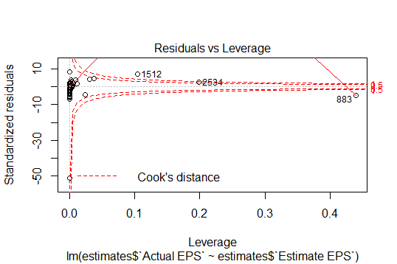
Assessment of Outliers/Cook’s Distance

Slide 16
Assumption Assessment
Residual seems to be heavy tailed (https://stats.stackexchange.com/questions/101274/how-to-interpret-a-qq-plot)
Outliers do not seem bad as most of them are within Cook’s distance
Correlation of Residuals and Fitted value is close to 0(3.797e-17)

Slide 17
Earning Surprise vs. Stock Performance
Stock Performance is measured by using Yahoo Finance API data and getting the closing price the day before the earnings announcement and closing price after the day of the announcement
Surprise is simply Actual EPS – Estimated EPS; That is, the dollar amount of whether over/underperformed predictions
Correlation of these to after excluding outliers(3223 companies) comes out to be 0.018

Slide 18
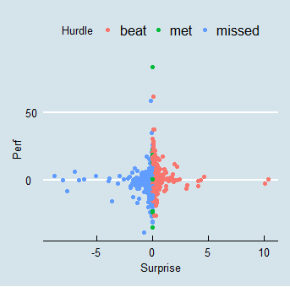
Earning Surprise vs. Stock Performance

Slide 19
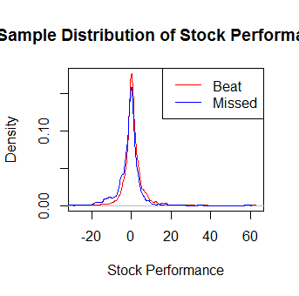
Performance Distribution of Stock for groups beat/missed

Slide 20
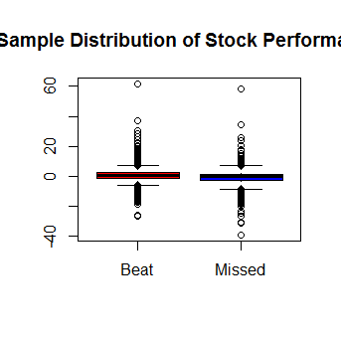
Boxplot of Beat/Missed Group

Slide 21
2 Sample T-test
Mean of Beat group is 0.86% vs. Mean of Missed group of -1.15%
95 percent confidence interval comes out to be [1.61, 2.42]
With p-value of less than 2.2e-16, conclusion comes out to be to reject the null hypothesis which is that true difference in means is equal to 0
That would seem contradictory compared to previous linear regression analysis

Slide 22
2 Sample T-Test Assumptions
Both samples were drawn from normal distributions(It seems both of them are heavy tailed distributed)
Both populations have same standard deviations(This could be true)
Sample observations are randomly drawn and independent(This assumption can be highly suspect)

Slide 23
Conclusion
It seems that despite 2-Sample T-test of Earnings Beat/Missed Groups, the analysis seems to suggest that the actual quarterly reported earnings are quite close to quarterly earnings predictions by Wall Street Analysts
There are less surprises for companies with more number of analysts covering the stock
The implication of this is that in general companies’ true quarterly earnings are quite well reflected in the analysts’ predictions, which means that it will not be easy to take advantage of market movements simply with true quarterly earnings alone, although it is considered as material non-public information

Slide 24
Further Studies
This study was only done for most recent quarters, and therefore it would be interesting to see how it looks going back to previous quarters(Also to keep track of future quarters)
Welcome any suggestions as to shortcoming of assumptions in using the model and if there is a way to overcome them

Slide 25
End

